Slide 1

Teaching material for a course in Software Project Management & Software Engineering – Part I

Slide 2
Chapter 3
In the previous chapter, we learned
How is a project initiated?
What is a project charter?
What is project scope?
What are the objectives in a project?
What project activities are performed during project initiation?
In this chapter, we will learn
How is an effort estimate for a project made?
What are the different effort estimation techniques?
How is a cost estimate for a project made?
What are the different cost estimation techniques?
How is a schedule estimate for a project made?
How is a resource estimate for a project made?

Slide 3
Part 1: Project Management Fundamentals
Chapter 3 (Effort & Cost Estimation)
Software projects are inherently effort driven because most of work involves human effort to build the software product.
Estimating the effort required to build the software product is difficult as the result of effort is intangible and difficult to make effort estimation in building software artifacts.

Slide 4
Estimation techniques
Experience-based techniques
Algorithmic cost modeling
Notes:
Talk about estimation in other engineering
For software planning such as activity network diagram that we discussed, plans are derived using experience
Experience-based techniques The estimate of future effort requirements is based on experience of one or more experts on past projects and the application domain. It implies to make an informed judgment of what the effort requirements are likely to be.
Algorithmic cost modeling In this approach, a formulaic approach is used to compute the project effort based on estimates of product attributes, such as size, and process characteristics, such as experience of staff involved.

Slide 5

Estimation techniques
In both cases, you need to use your judgment to estimate either the effort directly
or the project and product characteristics

Slide 6
Estimate uncertainty
B. Boehm et al. 1995

Slide 7
Part 1: Project Management Fundamentals
Chapter 3 (Effort & Cost Estimation)
There are many techniques like function point analysis, wide band delphi, COCOMO etc. for making effort estimation on software projects.
Depending on requirement, a suitable effort estimation technique is chosen for any software project.
Since effort estimation techniques are not foolproof, effort estimates need to be revised as the project progresses.

Slide 8
Some Popular Experience-based estimation approaches
Estimation by Analogy
Estimation by Expert Judgment

Slide 9
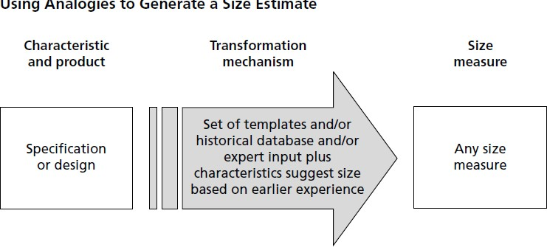
Estimation by Analogy
Estimate new projects by comparing them to similar past projects, preferably decomposing the estimate.
Using analogies to determine size measure.

Slide 10
Estimation by Analogy (1)
Step 1: Get detailed size results for a similar previous project:
Find the subsystems (DB, UI, Graphs/reports, Foundation classes, Business rules,…etc.).
Find the number of elements such as tables in DB, web pages for each subsystem.
Scope out the new system.

Slide 11
Example: AccSellerator is a past project, Triad is a new similar project
Subsystem | Actual Size of AccSellerator 1.0 | Estimated Size of Triad 1.0 | Multiplication Factor
Database | 10 tables | 14 tables | 1.4
User interface | 14 web pages | 19 web pages | 1.4
Graphs and reports | 10 graphs + 8 reports | 14 graphs + 16 reports | 1.7
Foundation classes | 15 classes | 15 classes | 1.0
Business rules | ??? | ??? | 1.5

Slide 12
Estimation by Analogy (2)
Step 2: Compare the size of the new Project to a similar past project.
Multiplication factor (subsystem) =
(number of elements in New) / (number of elements in Old)

Slide 13
Example: Step 2
Subsystem | Actual Size of AccSellerator 1.0 | Estimated Size of Triad 1.0 | Multiplication Factor
Database | 10 tables | 14 tables | 1.4
User interface | 14 web pages | 19 web pages | 1.4
Graphs and reports | 10 graphs + 8 reports | 14 graphs + 16 reports | 1.7
Foundation classes | 15 classes | 15 classes | 1.0
Business rules | ??? | ??? | 1.5

Slide 14
Estimation by Analogy (3)
Step 3: Build up estimate for the size of the new project.:
Size (new subsystem) =
Size (old subsystem) * Multiplication factor
Size (New project) =
sum of the sizes of its subsystems

Slide 15
Example: Step 3
Subsystem | Code Size of AccSellerator 1.0 | Multiplication Factor | Estimated Code size of Triad 1.0
Database | 5,000 | 1.4 | 7,000
User interface | 14,000 | 1.4 | 19,600
Graphs and reports | 9,000 | 1.7 | 15,300
Foundation classes | 4,500 | 1.0 | 4,500
Business rules | 11,000 | 1.5 | 16,500
TOTAL | 45,500 |  | 62,900

Slide 16
Estimation by Analogy (4)
Step 4: Create an effort estimate based on the size of the new Project.
Size Ratio =
Size(New Project)/Size (Old Project)
Estimated Effort (New Project) =
Effort (Old Project) * Size Ratio
If uncertain in a case of a subsystem:
produce an effort range, for instance, factor of 0.75 to 2.25 for 50% uncertainty.

Slide 17
Example: Step 4
Term | Value
Size of Triad 1.0 | 62,900 LOC
Size of AccSellerator 1.0 | ÷ 43,500 LOC
Size ratio | = 1.45
Effort for AccSellerator 1.0 | 30 staff months
Estimated effort for Triad 1.0 | 30 x 1.45 = 44 staff months

Slide 18
Some Popular Experience-based estimation approaches
Estimation by Analogy
Estimation by Expert Judgment

Slide 19
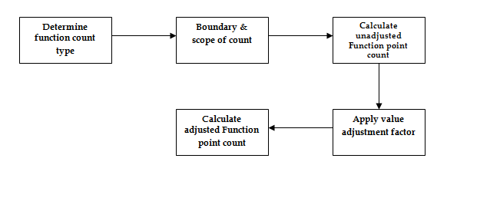
Part 1: Project Management Fundamentals
Chapter 3 (Project Effort Estimation)
Function point count for effort estimate (function point analysis technique)

Slide 20
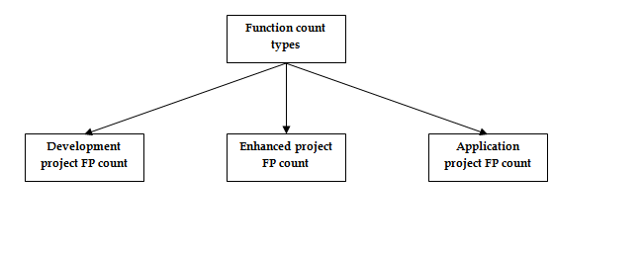
Part 1: Project Management Fundamentals
Chapter 3 (Project Effort Estimation)
Function count type for effort estimate (function point analysis technique)

Slide 21
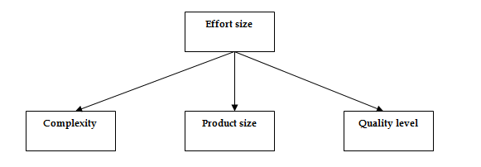
Part 1: Project Management Fundamentals
Chapter 3 (Project Effort Estimation)
Effort sizing for effort estimate (function point analysis technique)

Slide 22
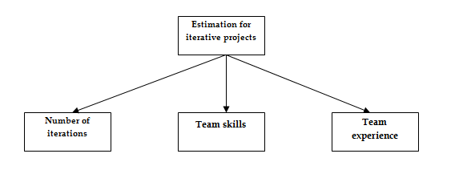
Part 1: Project Management Fundamentals
Chapter 3 (Project Effort Estimation)
Effort estimate for iterative projects

Slide 23
Function points analysis
Function point metrics provide a standardized method for measuring the various functions of a software application.
Function point metrics, measure functionality from the users point of view, that is, on the basis of what the user requests and receives in return

Slide 24
Objectives of FPA
Function point analysis measures software by quantifying the functionality the software provides to the user based primarily on logical design. With this in mind, the objectives of function point analysis are to:
Measure functionality that the user requests and receives
Measure software development and maintenance independently of technology used for implementation
In addition to meeting the above objectives, the process of counting function points should be:
Simple enough to minimize the overhead of the measurement process
A consistent measure among various projects and organizations

Slide 25
FPA Overview
The first step in calculating FP is to identify the counting boundary.
Counting boundary: The border between the application or project being measured and external applications or the user domain.
A boundary establishes which functions are included in the function point count

Slide 26
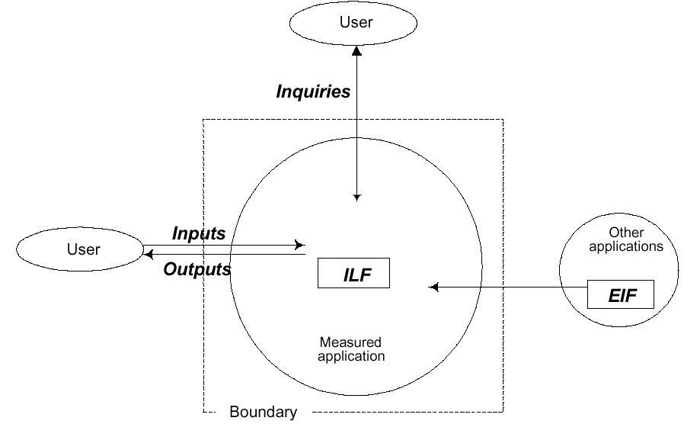
FPA Components

Slide 27
FPA Overview (Cont’d)
The next step is determining the unadjusted function point (UFP) count
UFP reflects the specific countable functionality provided to the user by the project or application

Slide 28
Calculation of the UFP
This calculation begins with the counting of the five function types of a project or application:
Two data function types
Three transactional function types

Slide 29
Data Function Types
Internal Logical File (ILF): a user identifiable group of logically related data or control information maintained within the boundary of the application
External Interface File (EIF): a user identifiable group of logically related data or control information referenced by the application, but maintained within the boundary of another application.
This means that EIF counted for an application, must be an ILF in another application

Slide 30
Transactional Function Types
External Input (EI): An EI processes data or control information that comes from outside the application’s boundary. The EI is an elementary process.
Elementary process: The smallest unit of activity that is meaningful to the end user in the business

Slide 31
Transactional Function Types (Con’d)
External Output (EO): An EO is an elementary process that generates data or control information sent outside the application’s boundary
External Inquiry (EQ): An EQ is an elementary process made up of an input-output combination that results in data retrieval

Slide 32
FPA Overview (Con’d)
These 5 function types are then ranked according to their complexity: Low, Average or High, using a set of prescriptive standards.
Organizations that use FP methods, develop criteria for determining whether a particular entry is Low, Average or High.
Nonetheless, the determination of complexity is somewhat subjective.

Slide 33
FPA Overview (Con’d)
After classifying each of the five function types, the UFP is computed using predefined weights for each function type

Slide 34
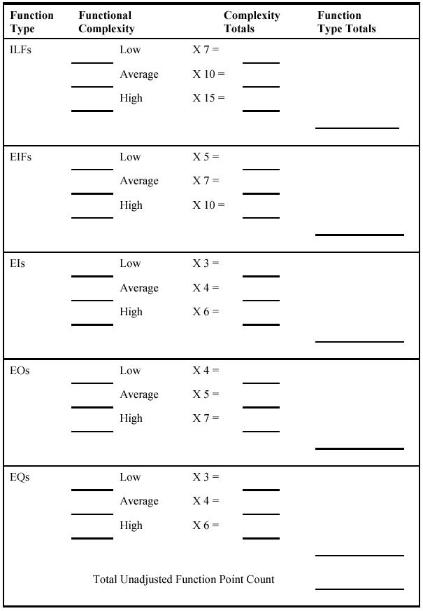
UFP Calculation Table

Slide 35
FPA Overview (Con’d)
The last step involves assessing the environment and processing complexity of the project or application as a whole.
In this step, the impact of 14 general system characteristics is rated on a scale from 0 to 5 in terms of their likely effect on the project or application

Slide 36
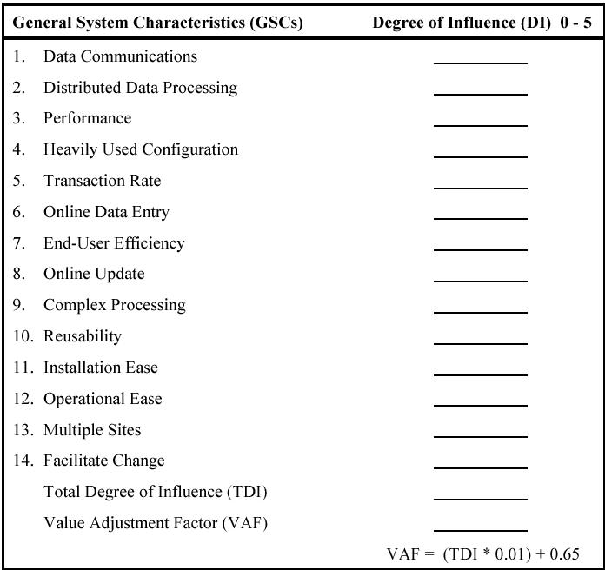
Value Adjustment Factor (VAF) Calculation Table
0 = No Influence
1 = Incidental
2 = Moderate
3 = Average
4 = Significant
5 = Essential

Slide 37
FPA Overview (Con’d)
On the whole:
FP = UFP xVAF
The constant values in the equation and the weighting factors are determined empirically

Slide 38
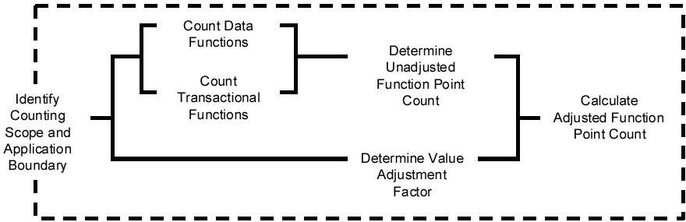
FPA Procedure at a Glance

Slide 39
An Example
Function Type | Estimated Count | Weight | FP-Count
EI | 24 | (Average) 4 | 96
EO | 16 | (Average) 5 | 80
EQ | 22 | (Average) 4 | 88
ILF | 4 | (Average) 10 | 40
ELF | 2 | (Average) 7 | 14
UFP count |  |  | 318

Slide 40
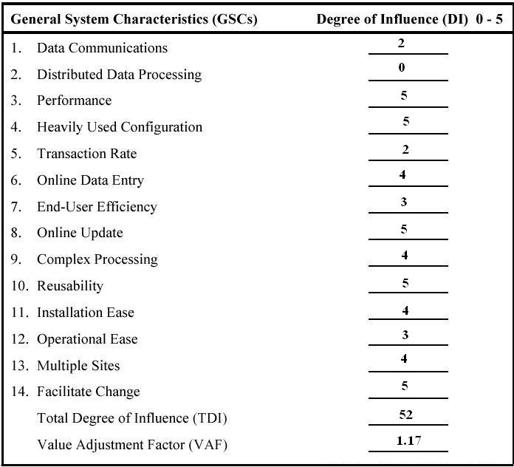
An Example (Cont’d)
VAF = 52 * 0.01 + 0.65
= 1.17
FP_{estimated} = 318 x 1.17
= 372

Slide 41
Problems of FPA
FPA has been criticized as not being universally applicable to all types of software.
For example, FPA doesn’t capture all functional characteristics of real-time software

Slide 42
Team Effort Estimate for a Project (Delphi)
Have each team member estimate pieces of the project individually, and then meet to compare estimates.
Discuss the differences among the individual results.
Average your estimates.
Arrive at a consensus estimate E that the whole group accepts.
Calculate a range of effort estimation values:
At the beginning of the project the range is approximately within +- 25%
– [min, max]: min = [E * 75%, E * 125%]
When the project advances the range is within +- 15% [min, max]: min = [E * 85%, E * 115%]
Notes:
Find consensus, i.e., estimate E that the whole group accepts

Slide 43
Experience-based approaches
Experience-based techniques rely on judgments based on experience of past projects and the effort expended in these projects on software development activities.
Typically, you identify the deliverables to be produced in a project and the different software components or systems that are to be developed.
You document these in a spreadsheet, estimate them individually and compute the total effort required.
It usually helps to get a group of people involved in the effort estimation and to ask each member of the group to explain their estimate.

Slide 44
Problem with experience-based approaches
The difficulty with experience-based techniques is that a new software project may not have much in common with previous projects.
Software development changes very quickly and a project will often use unfamiliar techniques such as machine learning, Large-Language Models, etc.
If you have not worked with these techniques, your previous experience may not help you estimate the effort required, making it more difficult to produce accurate costs and schedule estimates.

Slide 45
Algorithmic cost modelling
Cost is estimated as a mathematical function of product, project and process attributes whose values are estimated by project managers:
Effort = A ∗ Size^{B} ∗ M
A is an organisation-dependent constant, B reflects the disproportionate effort for large projects and M is a multiplier reflecting product, process and people attributes.
Most models are similar, but they use different values for A, B and M.
The most used product attribute for cost estimation is code size.
Notes:
B: This reflects the fact that costs do not usually increase linearly with project size
M: e.g., dependability requirements for the software and the experience of the development team

Slide 46
Estimate number of lines of code in a system
Compare the system to be developed with similar systems and use their code size as the basis for your estimate
Estimate the number of function or application points in the system and formulaically convert these to lines of code in the programming language used
Rank the system components using judgment of their relative sizes and use a known reference component to translate this ranking to code sizes

Slide 47
Estimation accuracy
The size of a software system can only be known accurately when it is finished.
Several factors influence the final size
Use of reused systems and components;
Programming language;
Distribution of system.
As the development process progresses then the size estimate becomes more accurate.
The estimates of the factors contributing to B and M are subjective and vary according to the judgment of the estimator.

Slide 48
Effectiveness of algorithmic models
Algorithmic cost models are a systematic way to estimate the effort required to develop a system. However, these models are complex and difficult to use.
There are many attributes and considerable scope for uncertainty in estimating their values.
This complexity means that the practical application of algorithmic cost modeling has been limited to a relatively small number of large companies, mostly working in defense and aerospace systems engineering.

Slide 49
COCOMO cost modeling
Notes:
COCOMO: constructive cost modeling

Slide 50
COCOMO cost modeling
An empirical model based on project experience.
Well-documented, ‘independent’ model which is not tied to a specific software vendor.
Long history from initial version published in 1981 (COCOMO-81) through various instantiations to COCOMO 2 (1995) .
COCOMO 2 considers different approaches to software development, reuse, etc.
Notes:
was derived by collecting data from a large number of software projects
Constructive Cost Model

Slide 51
COCOMO 2 models
COCOMO 2 incorporates a range of sub-models that produce increasingly detailed software estimates.
The sub-models in COCOMO 2 are:
Application composition model. Used when software is composed from existing parts.
Early design model. Used when requirements are available but design has not yet started.
Reuse model. Used to compute the effort of integrating reusable components.
Post-architecture model. Used once the system architecture has been designed and more information about the system is available.
Notes:
Post-architecture model: use formula mentioned in the intro with 17 multipliers
Early design model: use formula mentioned in the intro with 7 multipliers
Application composition model: for early prototyping efforts

Slide 52
CoCoMo 2
The basic CoCoMo model assumes that the effort is only a function of the number of lines of code and some constants evaluated according to the type of software system.
However, no system’s effort and schedule can be calculated based just on kdsi.
Moreover, estimates are required at different stages in the system life cycle and CoCoMo II has been designed to accommodate this by having models for three different stages.
Notes:
KDSI=Kilo Delivered Source Instructions

Slide 53
COCOMO estimation models
Notes:
Application composition model. Used when software is composed from existing parts.
Early design model. Used when requirements are available but design has not yet started.
Reuse model. Used to compute the effort of integrating reusable components.
Post-architecture model. Used once the system architecture has been designed and more information about the system is available.

Slide 54
Early-design stage example
The following model can be used to calculate an estimate of person-months.
where p-m is the effort in ‘person-months’, A is constant (which was set in 2000 at 2.94), size is measured in kdsi, and sf is exponent scale factor and em are the effort multipliers.
where B is a constant currently set at 0.91. The effect of the exponent scale factor is to increase the effort predicted for large projects.
p-m = A * (SIZE )^{sf} × em₁ × em₂ … × em_{n}
sf = B+0.01 × ∑(exponent driver ratings)

Slide 55
Scale factor values
Development flexibility (FLEX)
The number of possibilities to meet the requirements
Architecture/risk resolution (RESL)
The degree of uncertainty about the requirements
Team cohesion (TEAM)
The degree to which there is a large dispersed team
Process maturity (PMAT)
The more structure and organized the software is produced, the lower the uncertainty and the lower the rating for this exponent driver
Precedentedness (PREC)
The degree to which there are similar cases in the past, for the project that is being planned.

Slide 56
Part 1: Project Management Fundamentals
Chapter 3 (Effort & Cost Estimation)
Once effort estimates are made for the project, cost estimates are calculated based on the effort estimate and cost parameters like hourly salary of individual employees.
Cost estimates are done using techniques like activity based costing or cost factor analysis.

Slide 57
Part 1: Project Management Fundamentals
Chapter 3 (Effort & Cost Estimation)
Software projects use different kinds of software development life cycle models like waterfall model, iterative model etc. Effort estimation for each type of software development lifecycle model requires understanding the difference in the way the software product is built. In iterative models, software products are built in small incremental cycles. On the contrary in the waterfall model, software products are built in one go and thus all product features are fully built in the same one cycle. This fundamental difference necessitates a different approach to effort estimation for each type of software development lifecycle model projects.

Slide 58
Part 1: Project Management Fundamentals
Chapter 3 (Effort & Cost Estimation)
Software products are made manually by software engineers. How many of these people are needed on the project and for how long, is determined by the effort estimate and project duration.
Resource estimation also needs to take into consideration the skill set required on the project. Off course speed with which a software engineer can build a software product varies and thus this factor can affect resource estimation on the project.

Slide 59
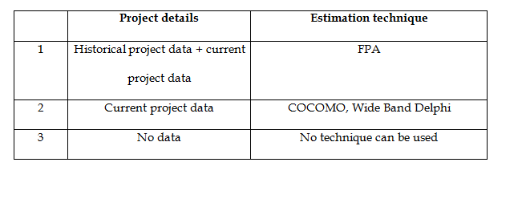
Part 1: Project Management Fundamentals
Chapter 3 (Project Effort Estimation)
Comparison of effort estimate techniques

Slide 60
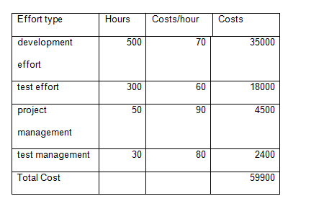
Part 1: Project Management Fundamentals
Chapter 3 (Project Effort Estimation)
Effort and cost for various project tasks

